Slide 1
Decision Learning I Session 23
Course : COMP6228 – Artificial Intelligence
Effective Period : February 2018

Slide 2
Learning Objective
After completing this session, students are expected to be able to:
LO 2 : Explain concepts of AI Techniques in Games
LO 3 : Designing AI game
LO 4 : Construct AI game

Slide 3
Content
Naïve Bayes Classifiers
Decision Tree Learning
Reinforcement Learning

Slide 4
Decision Learning
To realize the potential of learning AI, we need to allow the AI to learn to make decisions.
Learning is probabilistic; you will usually have some probability (however small) of carrying out each possible action.
Learning hard constraints is notoriously difficult to combine with learning general patterns of behavior suitable for outwitting human opponents.

Slide 5
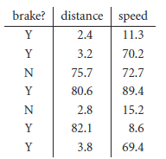
Naïve Bayes Classifiers
Suppose we are writing a racing game and we want an AI character to learn a player’s style of going around corners. There are many factors that determine cornering style, but for simplicity let’s look at when the player decides to slow down based only on their speed and distance to a corner. To get started we can record some gameplay data to learn from. Here is a table that shows what a small subset of such data might look like:

Slide 6
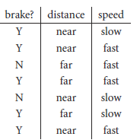
Naïve Bayes Classifiers
It is important to make the patterns in the data as obvious as possible; otherwise, the learning algorithm will require so much time and data that it will be impractical.
So the first thing you need to do when thinking about applying learning to any problem is to look at your data.
We will codify this by labelling distances below 20.0 as “near” and “far” otherwise. Similarly, we are going to say that speeds below 10.0 are considered “slow”, otherwise they are “fast”. This gives us the following table of binary discrete attributes:

Slide 7

Naïve Bayes Classifiers
We want to learn the conditional probability that a player would decide to brake given their distance and speed to a corner. The formula for this is:
The next step is to apply Bayes rule:
The important point about Bayes rule is that it allows us to express the conditional probability of A given B, in terms of the conditional probability of B given A. We’ll see why this is important when we try to apply it. But first we’re going to re-state Bayes rule slightly as:

Slide 8
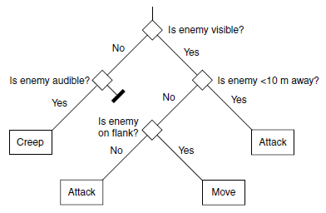
Decision Tree Learning
Decision trees: a series of decisions that generate an action to take based on a set of observations.
At each branch of the tree some aspect of the game world was considered and a different branch was chosen. Eventually, the series of branches lead to an action.

Slide 9
Decision Tree Learning
ID3
Depending on whom you believe, ID3 stands for “Inductive Decision tree algorithm 3”or “Iterative Dichotomizer 3.” It is a simple to implement, relatively efficient decision tree learning algorithm.
Like any other algorithm it has a whole host of optimizations useful in different situations. It has been largely replaced in industrial AI use by optimized versions of the algorithm: C4, C4.5, and C5.

Slide 10
Decision Tree Learning
ID3
The basic ID3 algorithm uses the set of observation–action examples. Observations in ID3 are usually called “attributes.” The algorithm starts with a single leaf node in a decision tree and assigns a set of examples to the leaf node.
It then splits its current node (initially the single start node) so that it divides the examples into two groups.
This algorithm is recursive: starting from a single node it replaces them with decisions until the whole decision tree has been created

Slide 11
Decision Tree Learning
Example
Problem: decide whether to wait for a table at a restaurant, based on the following attributes:
Alternate: is there an alternative restaurant nearby?
Bar: is there a comfortable bar area to wait in?
Fri/Sat: is today Friday or Saturday?
Hungry: are we hungry?
Patrons: number of people in the restaurant (None, Some, Full)
Price: price range ($, $$, $$$)
Raining: is it raining outside?
Reservation: have we made a reservation?
Type: kind of restaurant (French, Italian, Thai, Burger)
Wait Estimate: estimated waiting time (0-10, 10-30, 30-60, >60)

Slide 12
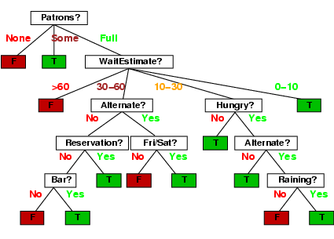
Decision Tree Learning
Inducing decision trees from examples
One possible representation for hypotheses
E.g., here is the “true” tree for deciding whether to wait:

Slide 13
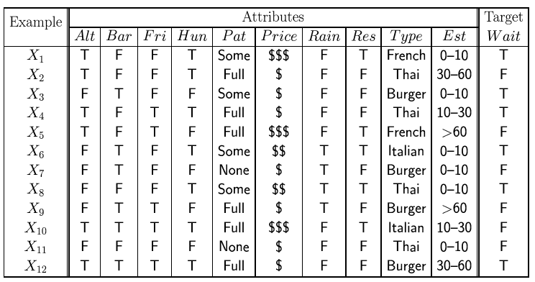
Decision Tree Learning
Attribute-based representations
Examples described by attribute values (Boolean, discrete, continuous)
E.g., situations where I will/won't wait for a table:
Classification of examples is positive (T) or negative (F)

Slide 14
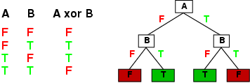
Decision Tree Learning
Expressiveness
Decision trees can express any function of the input attributes.
E.g., for Boolean functions, truth table row → path to leaf:
Trivially, there is a consistent decision tree for any training set with one path to leaf for each example (unless f nondeterministic in x) but it probably won't generalize to new examples
Prefer to find more compact decision trees

Slide 15
Reinforcement Learning
Reinforcement learning is the name given to a range of techniques for learning based on experience. In its most general form a reinforcement learning algorithm has three components: an exploration strategy for trying out different actions in the game, a reinforcement function that gives feedback on how good each action is, and a learning rule that links the two together. Each element has several different implementations and optimizations, depending on the application.
Reinforcement learning is a hot topic in game AI, with more than one new AI middleware vendor using it as a key technology to enable next-generation gameplay

Slide 16
Reinforcement Learning
Q-Learning’s Representation of the World
Q-learning treats the game world as a state machine. At any point in time, the algorithm is in some state.
The state should encode all the relevant details about the character’s environment and internal data.
Q-learning is known as a model-free algorithm because it doesn’t try to build a model of how the world works. It simply treats everything as states. Algorithms that are not model free try to reconstruct what is happening in the game from the states that it visits. Model-free algorithms, such as Q-learning, tend to be significantly easier to implement.

Slide 17
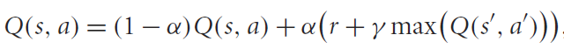
Reinforcement Learning
Doing Learning
Q-learning is named for the set of quality information (Q-values) it holds about each possible state and action. The algorithm keeps a value for every state and action it has tried. The Q-value represents how good it thinks that action is to take when in that state.
The experience tuple is split into two sections. The first two elements (the state and action) are used to look up a Q-value in the store. The second two elements (the reinforcement value and the new state) are used to update the Q-value based on how good the action was and how good it will be in the next state.
The update is handled by the Q-learning rule:

Slide 18
References
Ian Millington. 2009. Artificial intelligence for games. Morgan Kaufmann Publishers. Burlington. ISBN:9780123747310
Stuart Russell. (2010). Artificial intelligence : a modern approach. 03. Pearson Education. New Jersey. ISBN: 9780132071482.
Reinforcement Learning, http://reinforcementlearning.ai-depot.com/
Monte-Carlo Tree Search: A New Framework for Game AI, http://www.aaai.org/Papers/AIIDE/2008/AIIDE08-036.pdf

